Slide 1
Wonderware APAC Hot Issues Monthly Call
By Wonderware APAC Team

Slide 2

SR Data Chart
Tech note & Tech alert
Hot Fix Update
Open Forum

Slide 3
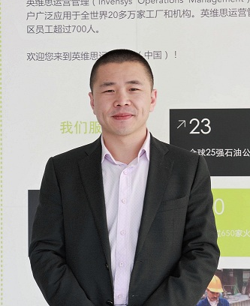
Part One: SR Data Chart
Presenter: Arnold. Zheng
Title :Senior Customer support manger
Email ID: Arnold.zheng@schneider-electric.com

Slide 4
Cases opened by Product :124
Cases opened by Country :124

Slide 5

Part Two: Tech Notes & Tech Alerts
Presenter: Bihua Lin
Title: Customer Support Engineer
Email ID: bihua.lin@schneider-electric.com

Slide 6
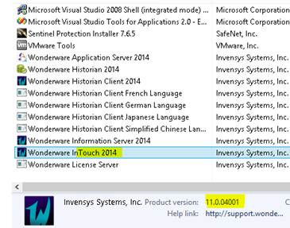
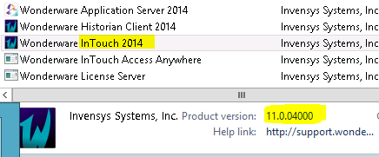
Tech Alerts Posted in May 2014
Tech Alert 191 InTouch 2014 Patch 01 Title Changes to 2014 in Control Panel After Installing InTouch Access Anywhere
Issue

Slide 7
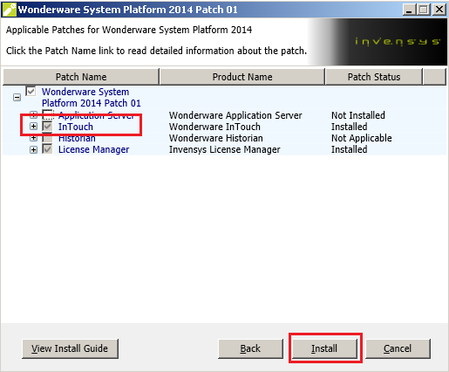
Tech Alerts Posted in May 2014
CR L00130662 was logged for this issue.
Workaround: Re-applying Patch 01

Slide 8
Tech Notes Posted in May 2014
Tech Note 1033 Using the Border Animation Feature in System Platform 2014 for InTouch Alarms
Tech Note 1035 Moving the Historian Runtime Database to Another Machine Using SQL Server 2012
Tech Note 1038 Changing the Historian Server Name in Existing HistClient Trend Files
Tech Note 1039 Tips for Resolving Demo Mode with Historian Client and WIS
Tech Note 1043 Wonderware Application Server Scripting Implementations Part 2: Read and Write Excel Data
Tech Note 1037 IntelaTrac Software Version Number Verification
Tech Note 1044 Configuring IIS MIME Types to View Recipe Manager Plus Help File Videos

Slide 9
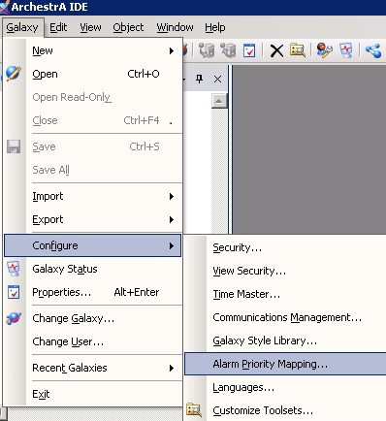
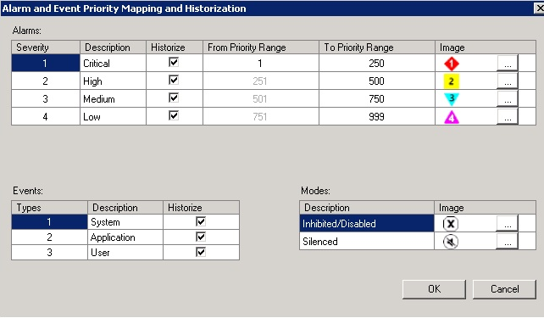
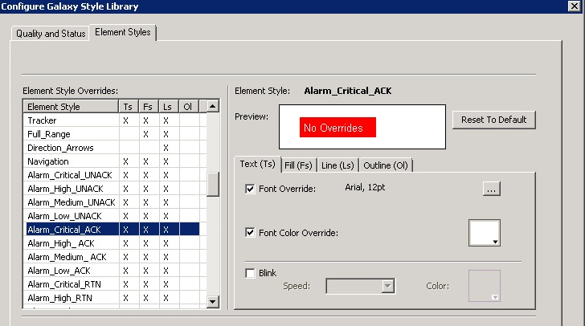
Tech Note 1033 Using the Border Animation Feature in System Platform 2014 for InTouch Alarms

Slide 10
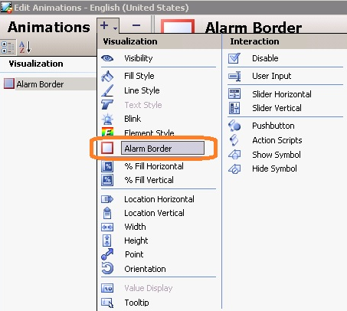
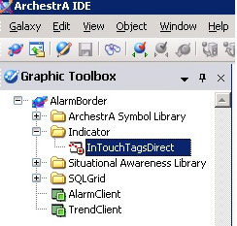
Tech Note 1033 Using the Border Animation Feature in System Platform 2014 for InTouch Alarms

Slide 11
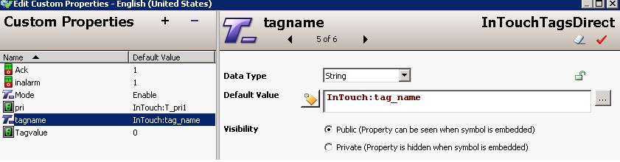
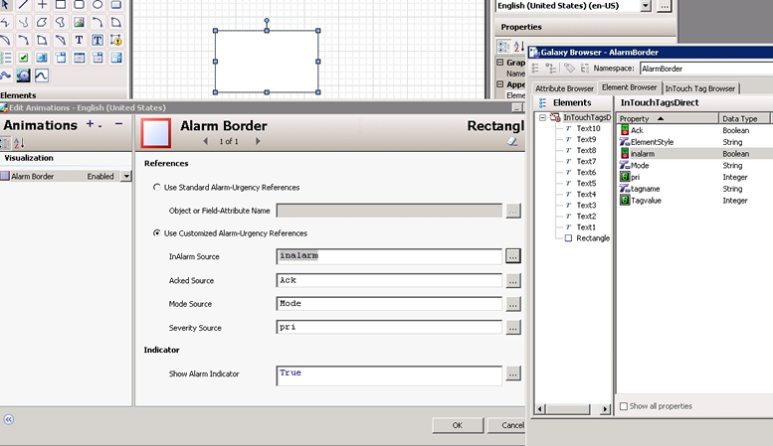
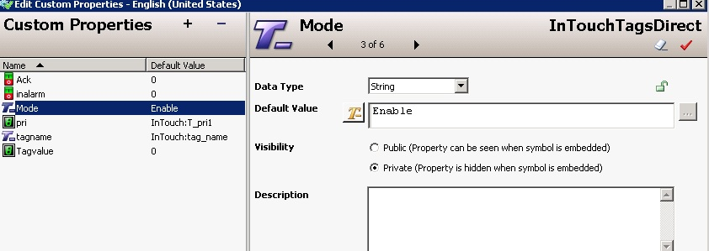
Tech Note 1033 Using the Border Animation Feature in System Platform 2014 for InTouch Alarms

Slide 12
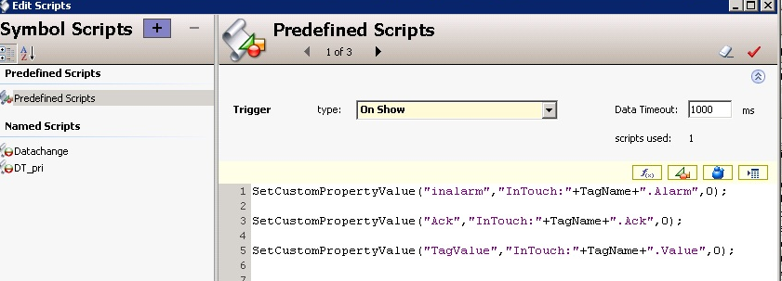
Tech Note 1033 Using the Border Animation Feature in System Platform 2014 for InTouch Alarms

Slide 13

Part three: Hot Fix Update
Presenter: Sarah Mao
Title: Customer support engineer
Email ID: sarah.mao@schneider-electric.com

Slide 14
HotFix released in May 2014
Totally 73
Detailed in “HotFix_Released from week 19~ week 25”
WW MES | 17
Industrial Application Server | 10
InBatch | 6
DAServer | 2
ActiveFactory | 1
Toolkit | 1
Extensibility | 1
InSQL | 12
Intelligence | 1
InTouch | 20
License Manager | 1
WIS | 1
Notes:
Text slide, with title and body text [from Slide Master]
This slide exists as a Slide Master and all type specifications and graphic elements are fixed. Simply type into the prompt boxes.
The layout is set as a Title Box and Text Box – within the Text Box there are five levels of type:
Level 1 – Body text set in Verdana Regular (18pt on 24pt linefeed) with ‘0.5 line’ space below each paragraph.
Level 2 – Bulleted body text set in Verdana Regular (18pt on 24pt linefeed) with ‘0.5 line’ space below each paragraph.
Level 3 – Bulleted body text (using a horizontal dash) set in Verdana Regular (16pt on 20pt linefeed) with ‘0.5 line’ space below each paragraph.
Level 4 – Bulleted body text set in Verdana Regular (15pt on 18pt linefeed) with ‘0.5 line’ space below each paragraph.
Level 5 – Bulleted body text (using a horizontal dash) set in Verdana Regular (14pt on 17pt linefeed) with ‘0.5 line’ space below each paragraph.
Within standard body text, subheads are set in Verdana Bold at the same size as the body text.
Advancing through the text levels
To advance to each text level from the previous one you can use the ‘Increase Indent’ and ‘Decrease Indent’ buttons on the ‘Formatting’ toolbar in PowerPoint®.
While the text position is fixed, the text box will grow as you enter further content in the slide – therefore, care should be taken to keep within the present text box margins.

Slide 15
HFs for 2012 R2 P01 release
2012 R2 P01 Release
InTouch 2012R2 (v10.6 P01)
L00131474 L00131307 L00131597
L00131620 L00131812 L00131912
L00131431 L00131912
Application Server 2012R2(v3.6 P01)
L00131581 L00131581 L00131155
L00131579 L00131885
Historian Server 2012 R2 (v11.0 P01)
L00131001 L00131591 L00131197
Notes:
Text slide, with title and body text [from Slide Master]
This slide exists as a Slide Master and all type specifications and graphic elements are fixed. Simply type into the prompt boxes.
The layout is set as a Title Box and Text Box – within the Text Box there are five levels of type:
Level 1 – Body text set in Verdana Regular (18pt on 24pt linefeed) with ‘0.5 line’ space below each paragraph.
Level 2 – Bulleted body text set in Verdana Regular (18pt on 24pt linefeed) with ‘0.5 line’ space below each paragraph.
Level 3 – Bulleted body text (using a horizontal dash) set in Verdana Regular (16pt on 20pt linefeed) with ‘0.5 line’ space below each paragraph.
Level 4 – Bulleted body text set in Verdana Regular (15pt on 18pt linefeed) with ‘0.5 line’ space below each paragraph.
Level 5 – Bulleted body text (using a horizontal dash) set in Verdana Regular (14pt on 17pt linefeed) with ‘0.5 line’ space below each paragraph.
Within standard body text, subheads are set in Verdana Bold at the same size as the body text.
Advancing through the text levels
To advance to each text level from the previous one you can use the ‘Increase Indent’ and ‘Decrease Indent’ buttons on the ‘Formatting’ toolbar in PowerPoint®.
While the text position is fixed, the text box will grow as you enter further content in the slide – therefore, care should be taken to keep within the present text box margins.

Slide 16
HFs for 2012 R2 P01 release
InTouch 2012R2 (v10.6 P01)
HF | Issue
L00131474 | ShowGraphic() function displays the symbol with increased height, behaves differently from Show Symbol Animation.
L00131307 | settings to disable graphic persistency do not work in InTouch 10.6 P01
L00131597 | Archestra Symbol shows Red cross and message "Not found" when GR Node is shutdown.
L00131620 | Error Message "Open: Object not found in the galaxy, may already be deleted." is observed when user selects Edit instance on an embedded ArchestrA Graphic where the instance of the object has containment with another object instance.
L00131812 | The edition of SmartSymbols ('Commit Changes') doesn't finish.
L00131912 | Certain characters of certain fonts become smaller in WindowViewer
L00131431 | Value of a tag does not get updated if there is an overlap with a Combo Box Windows Control.
L00131912 | Certain characters of certain fonts become smaller in WindowViewer

Slide 17
HFs for 2012 R2 P01 release
Application Server 2012R2(v3.6 P01)
HF | Issue
L00131581 | Unable to define description for scan group item error count alarms (scangroup.ItemErrorCntAlarm.DescAttrName) [ HF L00126276 needs to be ported to IAS 3.6 Patch1 ]
L00131581 | Unable to define description for scan group item error count alarms (scangroup.ItemErrorCntAlarm.DescAttrName) [ HF L00126276 needs to be ported to IAS 3.6 Patch1 ]
L00131155 | System Communication failure alarm keeps popping up even when communication is stable.
L00131579 | Field attributes do not always activate when referenced by scripts. Attributes can be stuck in initializing state, even when the script attempts to interact with that attribute.
L00131885 | "Following Attributes not found in instance..." status message is misleading. Proposed solution may be to completely eliminate this message to make it a SMC log message instead of status message.

Slide 18
HFs for 2012 R2 P01 release
Historian Server 2012 R2 P01
HF | Issue
L00131001 | Getting Value Validation Failed error.
L00131591 | Historian Server 11.0 returns strange data from legacy History block.
L00131197 | Performance of manual tag inserts decrease drastically when upgrading from InSQL8.0

Slide 19
HFs for 2014 P01 release
2014 P01 Release
InTouch 2014 P01 (v11.0 P01)
L00131488 L00131522 L00131960
Application Server 2014 P01 (v4.0 P01)
L00131752
Historian Server 2014 P01 (v11.5 P01)
L00131718 L00131743 L00131680
L00131680 L00131743 L00131946
Notes:
Text slide, with title and body text [from Slide Master]
This slide exists as a Slide Master and all type specifications and graphic elements are fixed. Simply type into the prompt boxes.
The layout is set as a Title Box and Text Box – within the Text Box there are five levels of type:
Level 1 – Body text set in Verdana Regular (18pt on 24pt linefeed) with ‘0.5 line’ space below each paragraph.
Level 2 – Bulleted body text set in Verdana Regular (18pt on 24pt linefeed) with ‘0.5 line’ space below each paragraph.
Level 3 – Bulleted body text (using a horizontal dash) set in Verdana Regular (16pt on 20pt linefeed) with ‘0.5 line’ space below each paragraph.
Level 4 – Bulleted body text set in Verdana Regular (15pt on 18pt linefeed) with ‘0.5 line’ space below each paragraph.
Level 5 – Bulleted body text (using a horizontal dash) set in Verdana Regular (14pt on 17pt linefeed) with ‘0.5 line’ space below each paragraph.
Within standard body text, subheads are set in Verdana Bold at the same size as the body text.
Advancing through the text levels
To advance to each text level from the previous one you can use the ‘Increase Indent’ and ‘Decrease Indent’ buttons on the ‘Formatting’ toolbar in PowerPoint®.
While the text position is fixed, the text box will grow as you enter further content in the slide – therefore, care should be taken to keep within the present text box margins.

Slide 20
HFs for 2014 P01 release
InTouch 2014 P01 (v11.0 P01)
HF | Issue
L00131488 | $AccessLevel goes to 9999 after invoking AttemptInvisibleLogon ()
L00131522 | Programmatic Graphic Generation Issues: 1. import failed with schema error. 2. the wizard option Orientation in the imported symbol is changed to vertical.
L00131960 | Fill bar and numeric value redraw issues.

Slide 21
HFs for 2014 P01 release
Application Server 2014 P01 (v4.0 P01)
HF | Issue
L00131752 | "Following Attributes not found in instance..." status message is misleading. Proposed solution may be to completely eliminate this message to make it a SMC log message instead of status message.

Slide 22
HFs for 2014 P01 release
Historian Server 2014 P01 (v11.5 P01)
HF | Issue
L00131718 | After a period of time sub set of tags are reporting status as IDAS overflow recovery.
L00131743 | cyclic storage/retrieval performance degradation
L00131680 | Request to port Hotfix-L00131001 to "SysPlatform 2014 Patch01" for Value Validation Failed errors.
L00131680 | Request to port Hotfix-L00131001 to "SysPlatform 2014 Patch01" for Value Validation Failed errors.
L00131743 | Request to port Hotfix-L00130833 to "SysPlatform 2014 Patch01" for cyclic storage/retrieval performance degradation
L00131946 | Some replication tags are not being updated in Tier2 Historian

Slide 23
Questions / Comments ?
Thank you!
Dara.du@schneider-electric.com

