Slide 1
AVEVA Teamwork
Bringing cloud-based knowledge sharing and collaboration to the connected worker

Slide 2
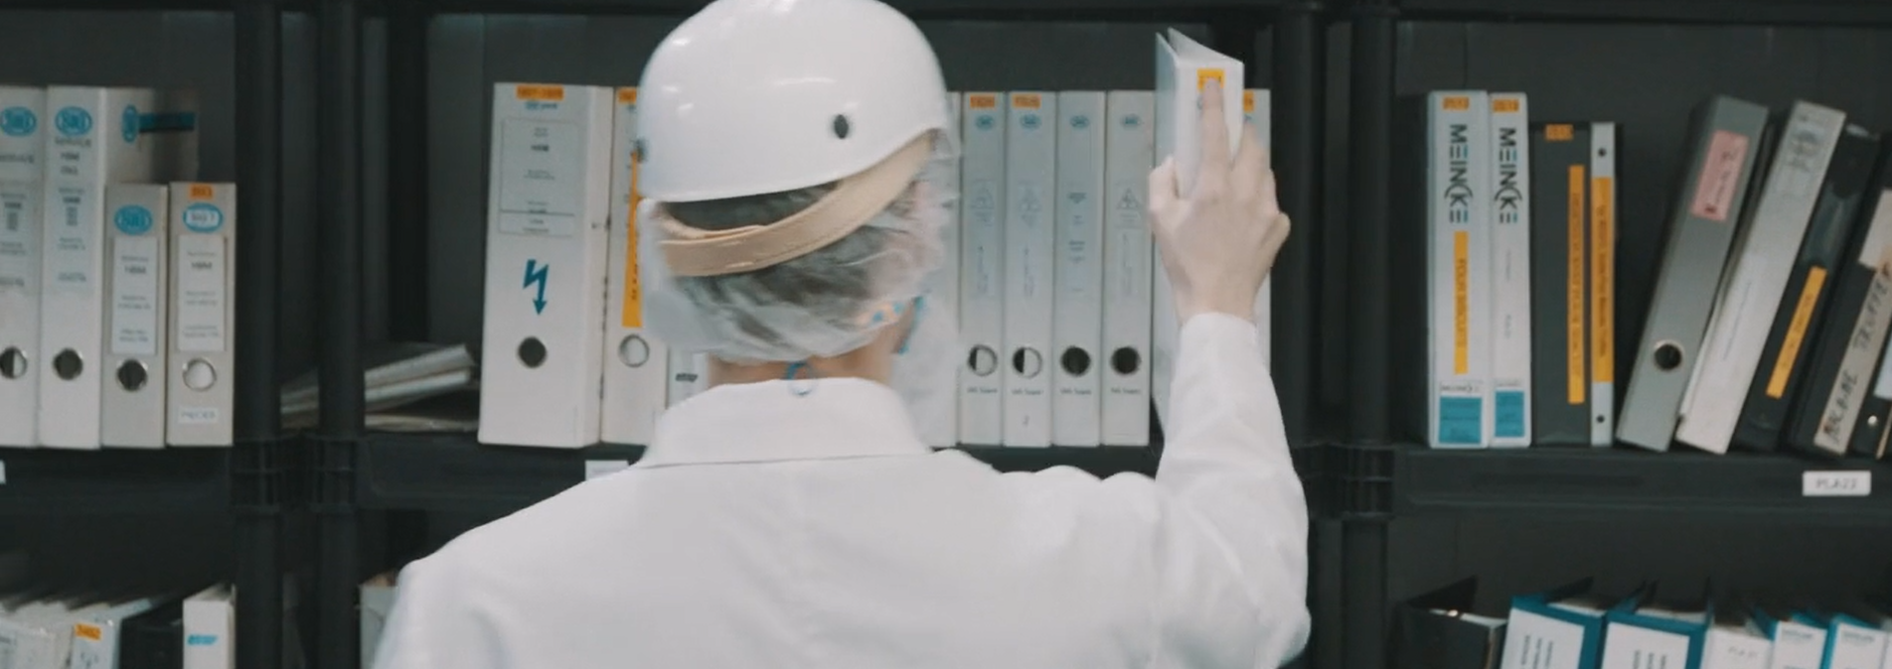
Challenges & Trends
Connected worker initiatives are gaining traction in industrial organizations.
Widespread implementation of digital transformation is introducing new technologies and processes.
Next generation of employees entering the workforce and advancing through the ranks are digital natives.
Boomers are retiring from all sectors at a rate of 10,000 a day in the United States.
Retiring has doubled over the past eight years and will continue to increase until the last of the boomers reach 65 around 2030.
Particularly challenging for manufacturers, as more than a quarter of manufacturing workers are over the age of 55.
Ineffective & Rapidly Changing Information
Critical information is not accessible
Written instructions are incomplete & out-of-date
Difficult to understand and retain
Fast changing environment with COVID-19 policies
Digital transformation implementation support
Skills Gap
Retiring workforce
Employee turnover / New hires
Increasingly complex equipment
Inconsistent performance between shifts and plants
Notes:
Despite our advances in automation and the progress of industry 4.0, many of the tools and processes we use in support of our daily operations are antiquated – production reports done on paper, skills tracked in Excel and issues tracked on white boards. The result is disconnected information not available at the point of need. Our team members are equally disconnected, with no ability to communicate or collaborate in real-time across shifts, departments or plants.
Our current way of capturing and sharing knowledge is not effective. Work instructions are stored in binders off the plant floor, they are often incomplete and out of date. The main reason being because instructions are still largely written and in paper format, making it time-consuming to create, update and publish. And these instructions are ineffective because reading text takes longer to understand and can be easily misinterpreted – if a picture is worth a thousand words; video is worth a million. We are also experiencing unprecedented change triggered by a global pandemic and a rise in remote work. Traditional written formats can’t keep up with the rapid pace of information in today’s industrial environments.
Retiring workforces are expected to increase over the next 10 years, leading to massive knowledge loss for organizations ill-prepared to capture it in a sustainable way. Employee turnover is also in the spotlight today as companies are forced to layoff staff during the pandemic turmoil, eventually staff will need to be brought back on, but it is unclear whether previous staff will return in great numbers or new employees will have to be hired and trained. In addition, many organizations are capitalizing on current conditions to modernize their equipment in anticipation of return to normal operations, this is leading to new and increasingly more complex equipment requiring new skillsets and knowledge. Larger organizations also experience inconsistent performance between shifts and plants.

Slide 3
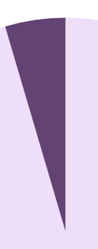
Addressing the Knowledge & Skills Gap
Operationally intensive companies have entered a new wave of automation and digitization. That will have a big impact on the skills they need to remain competitive.
66%
of 116 executives surveyed said skills are a top ten issue.*
7%
believe their companies are fully prepared to address the skill gaps that they expect over five years.*
*2017 McKinsey survey of 116 executives at large organizations
Notes:
These concerns are top of mind for many organizations; however they haven’t been equipped with the right technology and tools to effect change. McKinsey surveyed 116 executives and found the skills and knowledge gap is a top 10 issue for 66% of their companies, however only 7% of those believe they are prepared to address it. There is a need to capture knowledge and build skillsets to remain competitive due to growing trends.
https://www.mckinsey.com/business-functions/operations/our-insights/building-the-vital-skills-for-the-future-of-work-in-operations

Slide 4
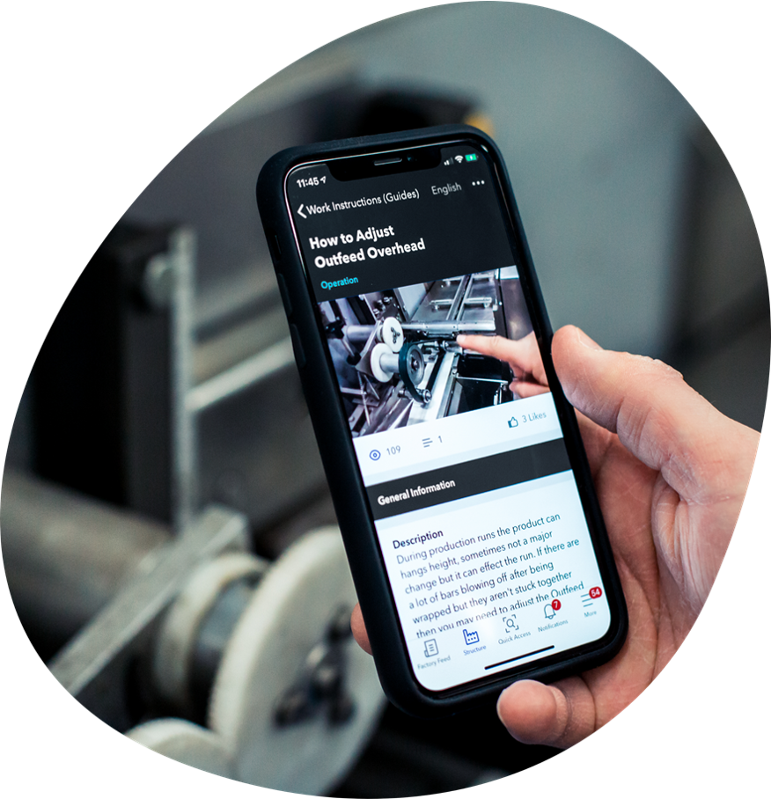
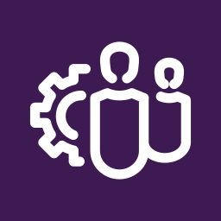
AVEVA Teamwork
A cloud-based performance support application designed to empower workers with the knowledge and digital resources they need to do their jobs effectively and increase plant productivity.
Speed up communications
Support work
Capture and share knowledge
Notes:
AVEVA Teamwork is a performance support application designed specifically for industrial operations, to empower workers with the knowledge & tools they need to improve plant productivity and drive excellence in their operations.

Slide 5

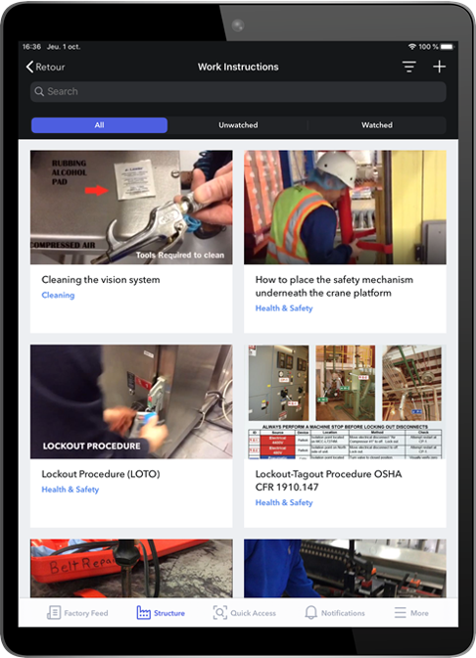
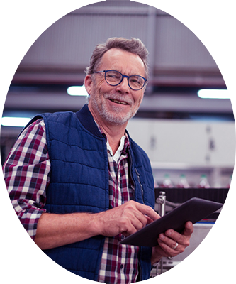

Bringing Knowledge & Digital Together
Experienced
Best Practices
Tribal Knowledge
Tech Savvy
Collaborative
Untapped Potential
Notes:
Teamwork brings the knowledge held by experienced workers together with digital technologies to engage and connect new workers. This creates a sustainable environment for knowledge retention and fosters collaboration between workforces.

Slide 6



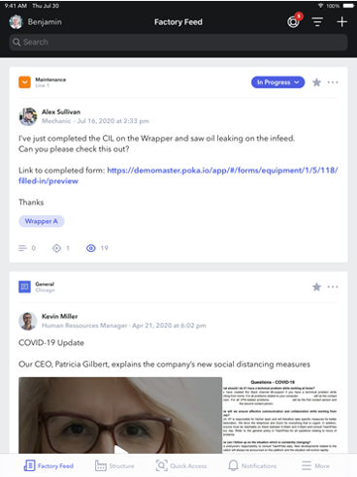

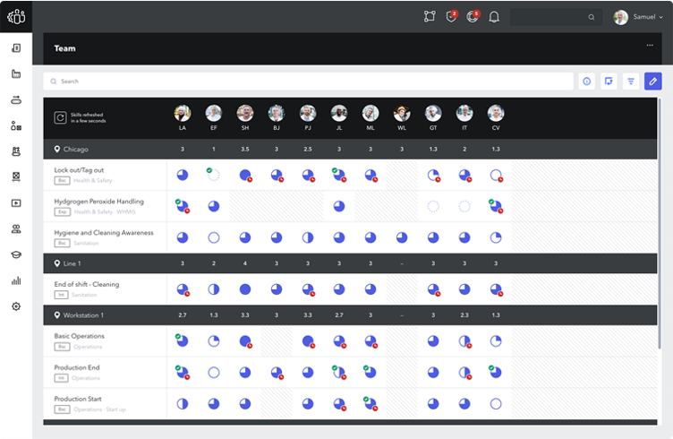




Connect Your Entire Workforce
MANAGEMENT
Real-time visibility into plant floor and daily operations
Website
WORKERS
Instant access to instructions at workstations
Solve problems and capture best practices in the flow of daily work
CORPORATE
Mobile App
Establish global standards and ensure compliance
Notes:
AVEVA Teamwork resolves knowledge and skills gap issues by connecting workers with the rest of your digital operations and workforce, and by providing them with instant access to the information they need directly at their workstations.
Workers collaborate in real-time to share important production related events, to solve problems, and capture ideas for continuous improvement
They use tablets to access how-to videos, training guides, work instructions and other information at their stations
This provides management with greater visibility into what’s happening on the plant floor at all times, which enables them to manage daily operations more efficiently
It also provides corporate stakeholders in health & safety, quality, and HR with greater control over upskilling, policies and provides a better way to track and enforce global standards and compliance
All managed through a cloud hosted application and accessible by users on mobile devices throughout their daily activities and a web browser for desk-based staff.

Slide 7
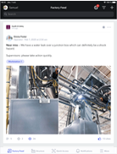

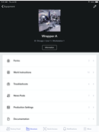
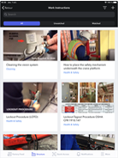
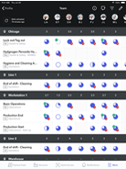
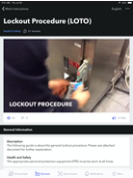
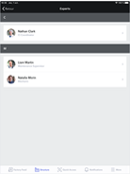
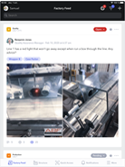
AVEVA Teamwork Areas of Focus
Communication
Digital Knowledge
Connect with workers across shifts and facilities to solve problems. Share insights in a logbook and continuously grow the archive of knowledge.
Scan QR codes to quickly access a standardized library of instructions, videos and troubleshooting content.
Collaboration
Factory Feed
Equipment
Video Library
Skills Management
Issues Management
Deliver and track training for new hires, upskilling and certifications with a review pane to view pending and completed training.
Capture, track and resolve problems through call for help escalation and collaboration with subject matter experts.
Users/Skills
Procedures
Subject Matter Experts
Call for Help
Notes:
AVEVA Teamwork’s capabilities can be grouped into four areas of focus:
Communication
Connect workers across shifts and plants to solve problems in real time
A digital logbook for workers and management to share important production updates
Capture and archive a continuously growing knowledge base of production events
“Digital Knowledge” (Knowledge Management)
A centralized digital library of work instructions, videos, troubleshooting solutions and more
Workers use tablets to scan QR codes and access information in seconds
Ensure a standardized way of working across global operations by creating an equipment network
Skills Management
Deliver and track training for new hires, operator upskilling and mandatory certifications
Multi-step training programs built to standardize employee skills development
The Skills matrix provides an "at-a-glance" view of completed, outstanding and pending training
Issues Management
Digitally capture, track, manage and resolve production problems
Support problem escalation, collaboration and task assignment to a global network of experts
Improve visibility into issues across operations through a real-time, digital Kanban view

Slide 8


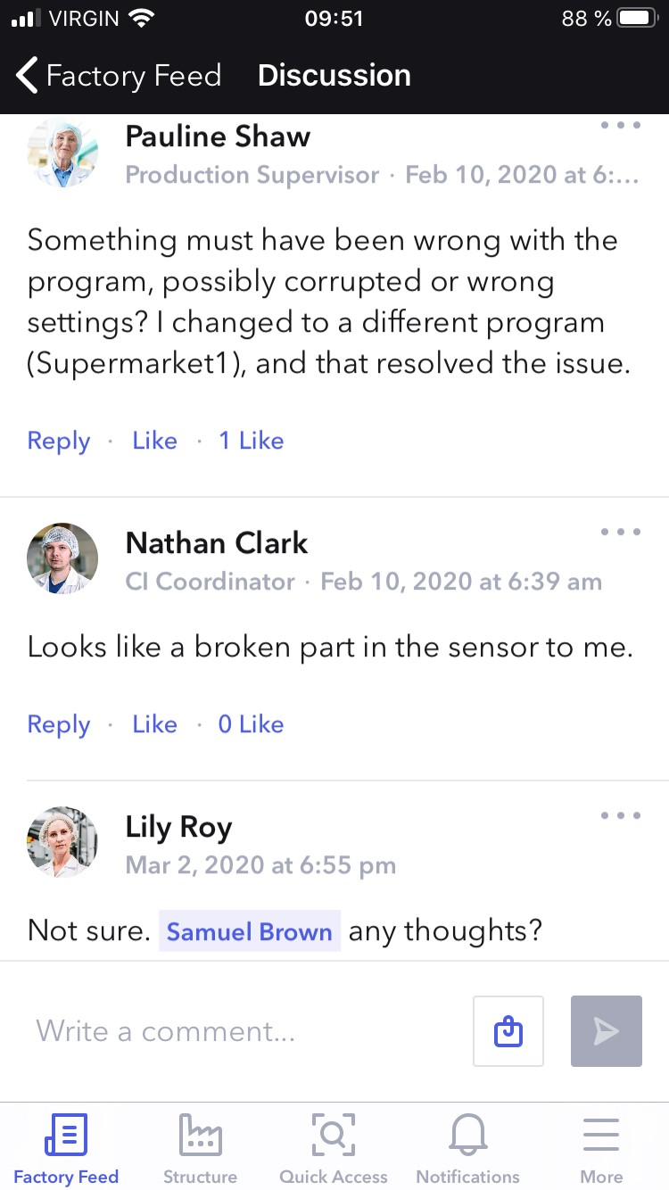
Communication
Designed to connect workers and teams using the cloud across shifts, departments, and plants, leading to better visibility and faster problem solving.
Stay up to date with the news feed
Filter notifications by type
Posts organized by channel, type, equipment, workstation, product & user tagging
Segment communication channels
Promote engagement with posts
Attach multimedia files
Assign permissions and moderation
Notes:
The Factory Feed empowers your workers to communicate and respond to issues on the plant floor in real-time, removing barriers that cause or prolong downtime.
Identify and address bottlenecks and waste by recording and sharing issues using images, video and text
News Types - Categorize and tag posts using configurable News Types for easy retrieval by others.
Call for Help – When a problem occurs, workers can put out an alert and directly request assistance in addressing the problem or identifying experts who can help resolve the issue. Eliminate wasted time caused by traditional inefficient escalation processes. Send out a digital alert to designated equipment experts and workers on the line across the organization (not just the mechanics on the floor) in the event of a production issue that can’t be resolved independently by the operator.
Equipment tagging - Keep a log of events and problems by tagging the equipment, products, and workstations in a post.
Communication channels – Publish news and events to specific channels to target communication only to those who need it. Channels can be at the Corporate, Department, Plant or Product Line level, and custom channels within these categories can further target the communication, minimizing unnecessary distractions for users.
Interactivity & collaboration – Comment on posts, offer solutions to problems, assign tasks to individuals helping to drive urgency and action among users.
Integrations (Triggers & cards)

Slide 9
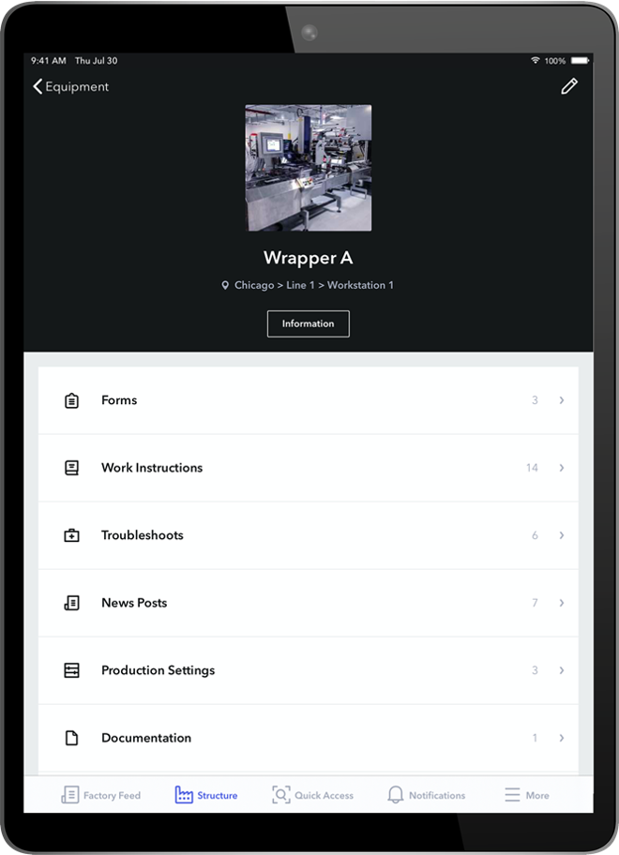
Digital Knowledge
Gives workers access to the information they need, when they need it, while contiguously capturing new improved ways of working.
Library of training materials, troubleshooting solutions and standard work instructions
Content structure mirrors operations environment
Multimedia centric with video, images, documents or links
Quick QR code access
Create forms & checklists for data collection
Content approval workflows & ISO compliant versioning
Report and analyze viewership
Translation & language management
Automatic sharing for common assets across sites
Restrict access to content
Notes:
AVEVA Teamwork’s digital knowledge, or knowledge management capabilities, make it possible to centralize all the important information pertaining to a machine, workstation or product and give workers the ability to access it in a matter of seconds.
This includes digital work instructions, micro-lessons and troubleshooting solutions that can be easily accessed using strategically placed QR codes throughout your production lines.
Documents, images, links and videos are supported.
Quick access at the point of need (on the shop floor) is facilitated by QR codes strategically placed throughout your operations.
Teamwork makes it possible to define and enforce approval workflows to ensures all the necessary stakeholders, from operations to health & safety, are consulted prior to content being published on Teamwork. Version control and version history helps address ISO compliance requirements.
Viewing reports keep track of who has seen which content.
Translation of instructions to other languages is made easier through the language management capabilities. Create a draft of a WI in a new language and copy over all the multimedia and structure in a single click.
The ability to easily share instructions for common assets and processes across plants is made possible thanks to the information structure based on ISA S95.
Visibility is controlled based on user roles ensuring only relevant content is visible to a user – reducing distractions and improving ease-of-use.

Slide 10
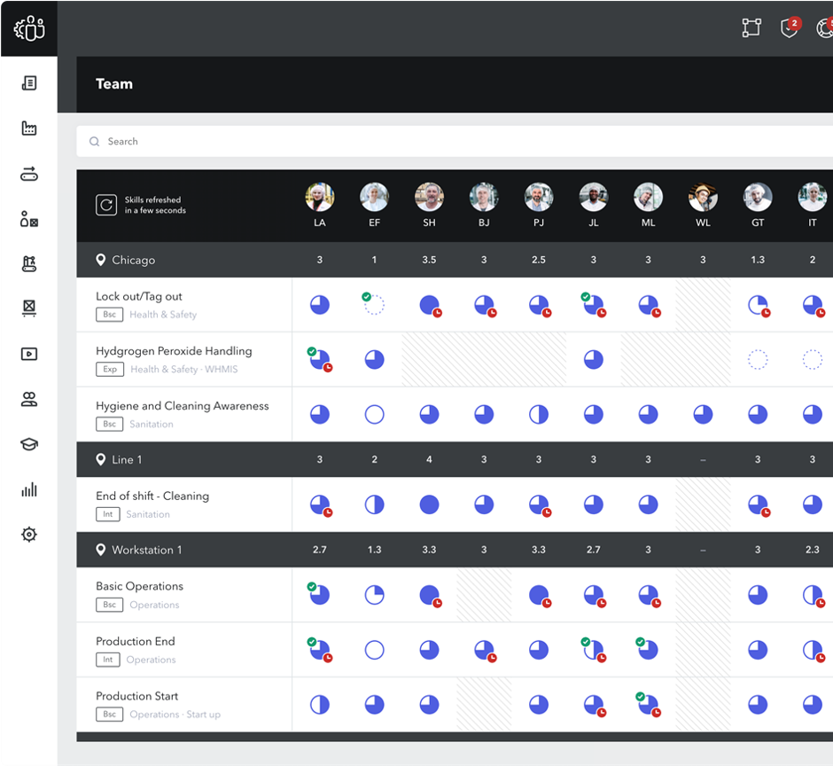
Skills Management
Defines a standardized way for workers and management to oversee and accelerate skills development.
Define multi-step training programs
Assign training to workers based on location and title
Create exams
Review skills in a matrix view
Revise training content & certifications
Grant endorsement and perform assessments
Report and export
Integration with Corporate LMS
Notes:
Unlike traditional corporate LMSs, AVEVA Teamwork skills management capabilities are built specifically to help oversee and track production skills.
Multi-step training programs can be defined for each skill and then assigned and tracked for employees. The steps in the training program can include guides and instructions already in Teamwork, as well as exams, and even mandatory shadowing periods or classroom training.
The Skills matrix provides and “at-a-glance” view of completed and pending training allowing supervisors to identify which operators have the skills to step in and cover a workstation, as well as gaps in coverage. Skills can be set to expire and require revision.
Teamwork skills can link to content in your LMS and can push updates to the LMS (i.e. when a skill level changes.)
Before a skill level is set, supervisors must indicate their endorsements. These “step up cards” or assessments are essentially an endorsement for each step of a skill. Assessments can be added as a step in a skill to enable trainers on the floor to formalize and capture the interim (not assessed, not mastered, mastered). Trainers often need to assess mid-training program while endorsements are done only at the end by a supervisor.

Slide 11
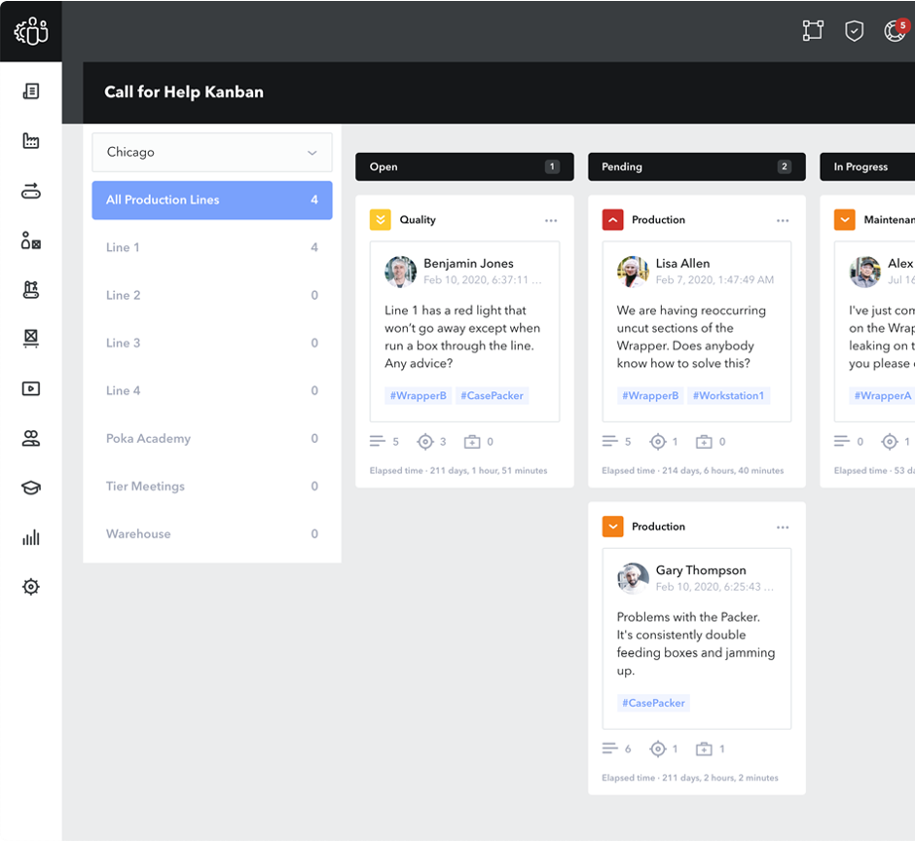
Issues Management
Operations leaders can centrally and comprehensively review and manage production problems leading to permanent solutions.
Problem feed captures operations related problems with text, photos and video
Route notifications and “Calls for Help” to experts
Tag equipment & workstations to create a digital logbook of past events
Review every area’s issues at-a-glance from the cloud (Kanban)
Assign tasks and receive status updates
Automatically convert issues into work instruction/troubleshooting solutions
Notes:
AVEVA Teamwork’s issues management capabilities help organizations identify, manage and solve production problems faster, more efficiently. Think of it as a “digital kaizen” app.
Teamwork gives operations leaders a centralized and comprehensive way to manage production problems leading to permanent solutions.
Factory feed where workers can post issues in real-time including photos and videos leading to a better and faster resolution to problems
Automatic notifications to designated experts across production lines, departments, shifts and even plants
The ability to tag equipment or workstations in problems posts leading to a centralized logbook an archive of all the production events tied to a piece of equipment. … this becomes a goldmine of insight for performance engineers
Issues can trigger work orders in a 3rd party CMMS, avoiding duplicate data entry
All issues can be accessed managed and filtered in a Kanban view – a digital alternative to your white board
Finally, Teamwork makes it possible to automatically convert a resolved issue into a draft of a troubleshooting solution – saving time and effort in standardizing and sharing best practices across your operations.

Slide 12
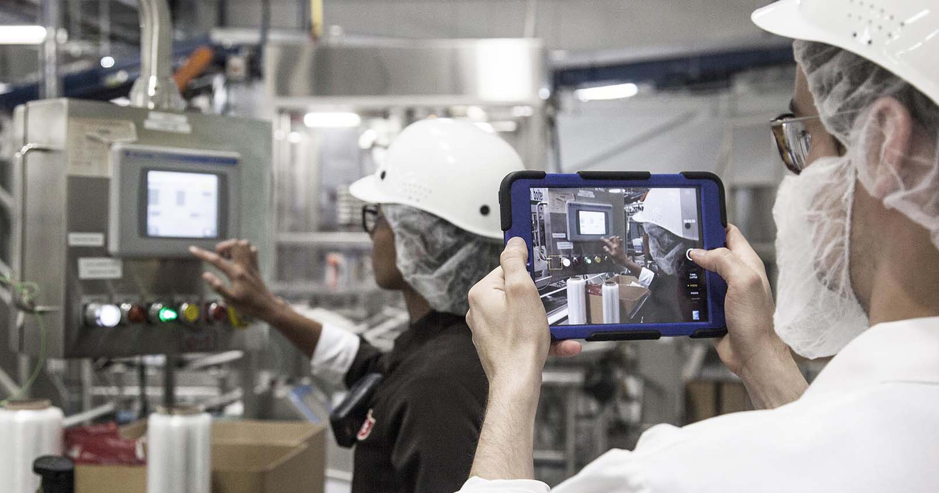
Continuous Improvement of Skills Knowledge
Identify Issues
Factory Feed, Dashboards & Forms
Solve Problems
Issues Management
Capture & Share
Digital Work Instructions & Troubleshoots
Train & Learn
Skills Development & Management
Apply & Improve
Checklists & Tasks
Notes:
Teamwork delivers all the features and functionality needed to close the continuous improvement loop in a single, integrated platform
Identify issues using the factory feed, dashboard and forms to shine a light on major and micro issues in your operations.
Problem escalation and issue tracking
Record, capture and share best practices from the multimedia knowledge base of work instructions and troubleshooting solutions that are easy to access on the shop floor.
Provide skills management, training programs and exams
And checklists and tasks to make sure instructions are followed
The benefit of bringing together all these capabilities into one single, worker-centric platform is that makes it easier and more cost-effective to maintain than cobbling separate point solutions. The seamlessness of these typically disparate, unconnected platforms makes for a better user experience and higher adoption, which is critical to effect actual change in behavior.

Slide 13
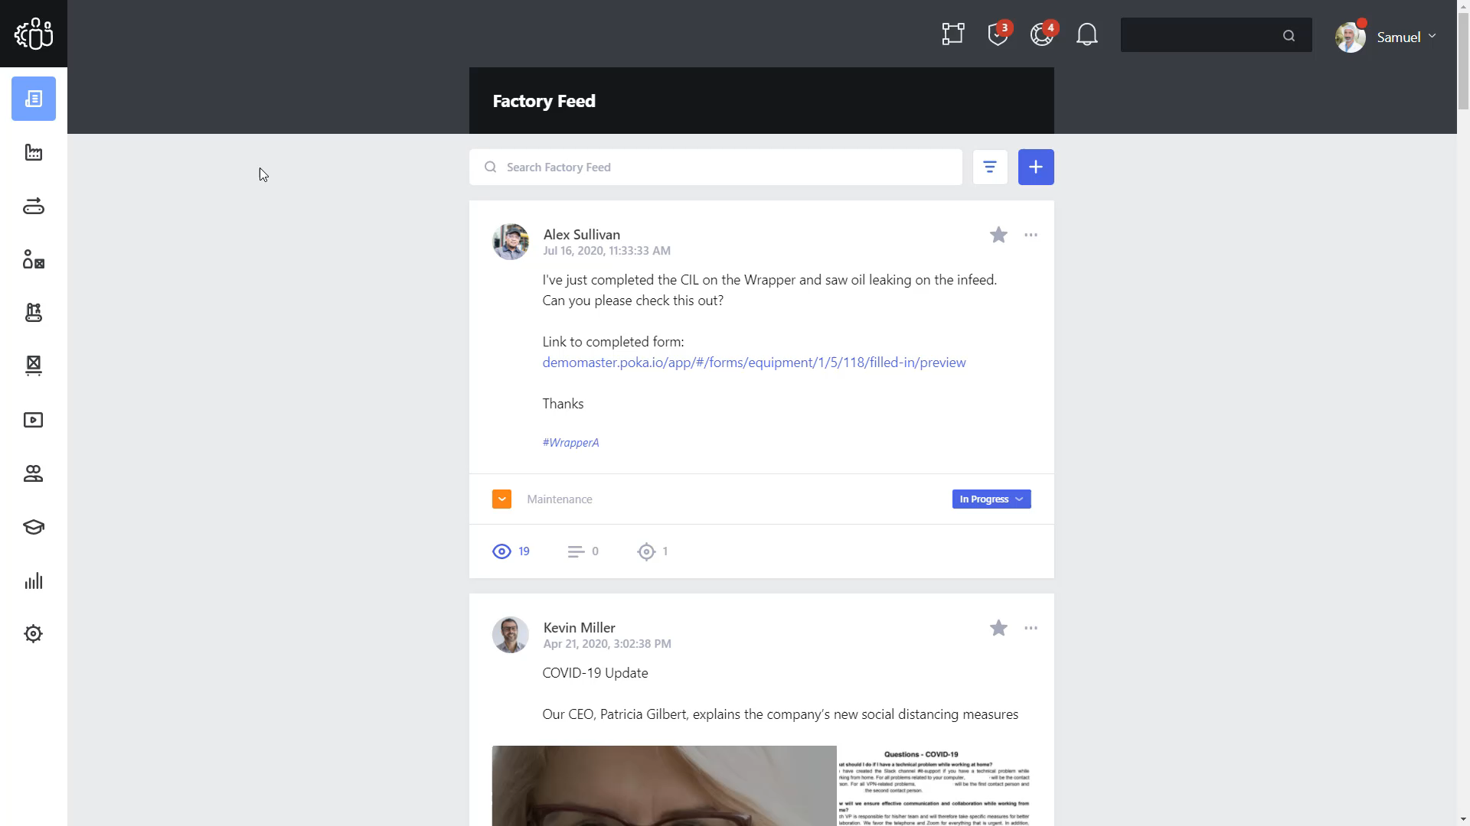
Quick Tour
Notes:
Partners have been given their own demonstration environment, which you should use here to manually navigate the Teamwork solution to guide the conversation. However, a quick tour demonstration video has also been embedded for a brief offline experience if the AVEVA Teamwork demo instance is inaccessible.

Slide 14
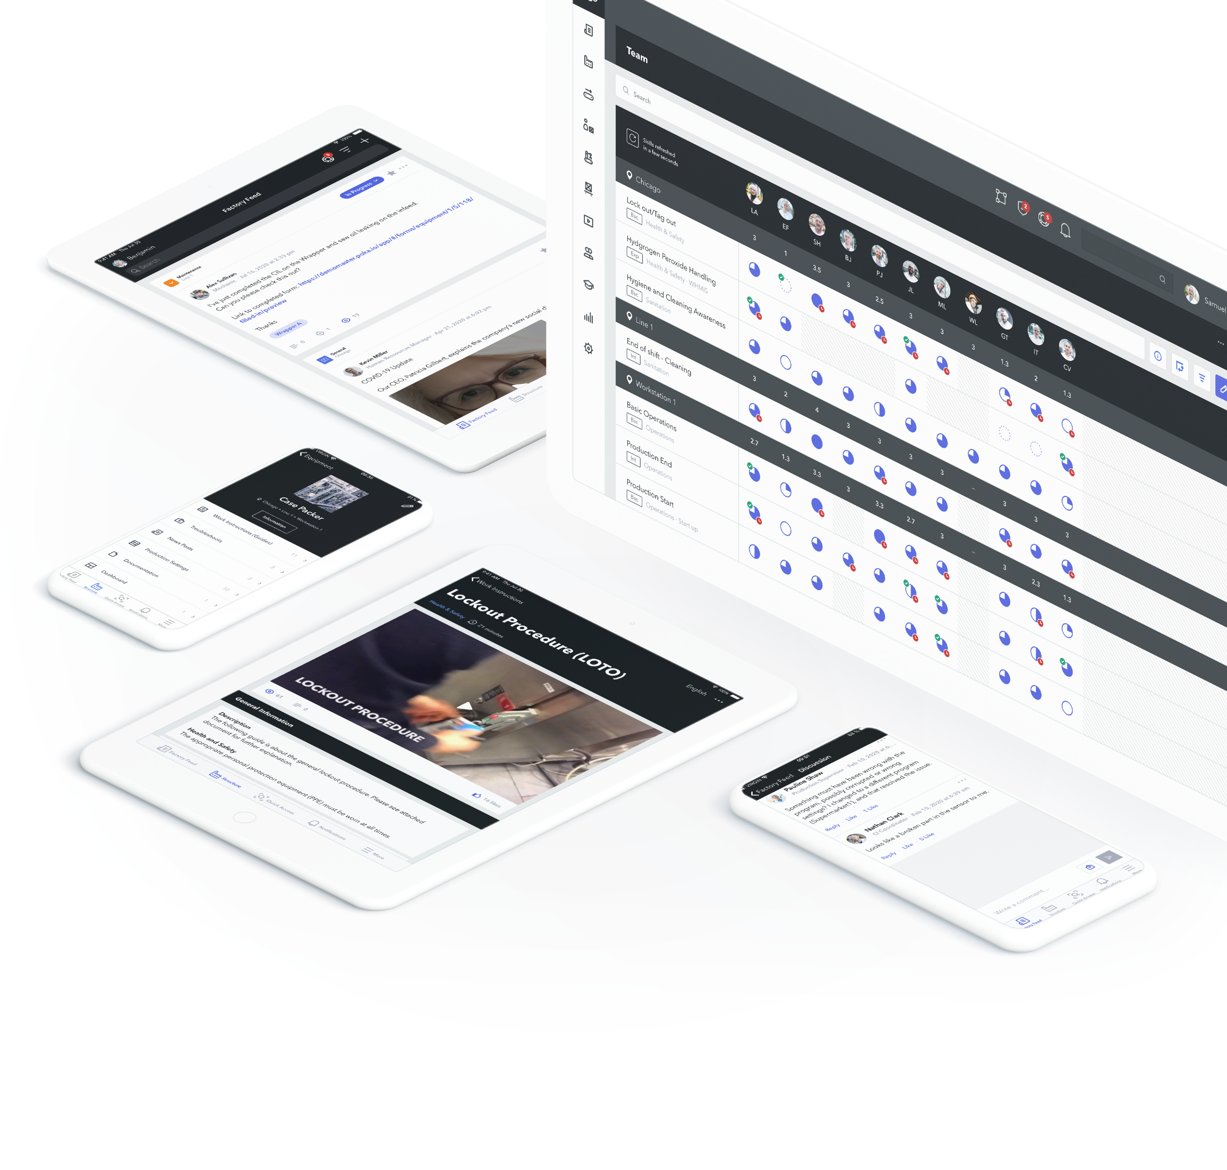
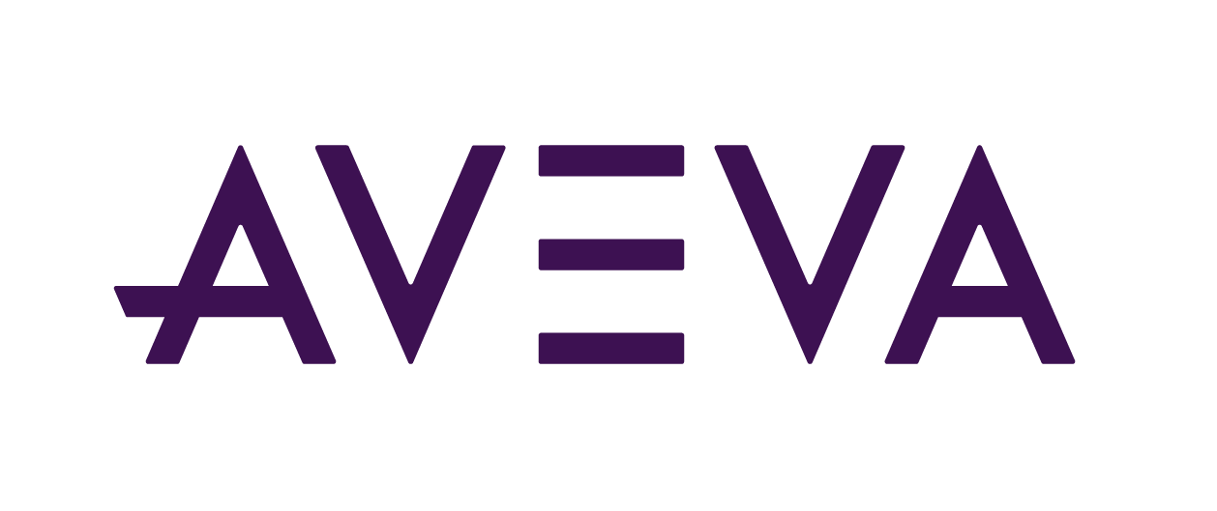




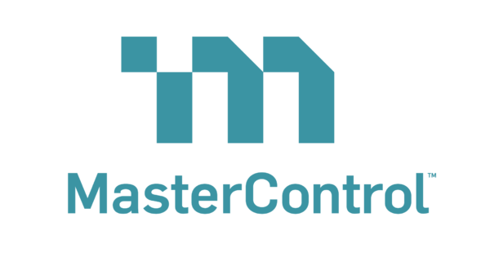
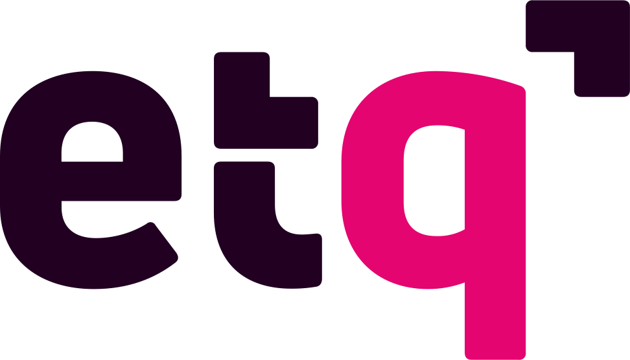
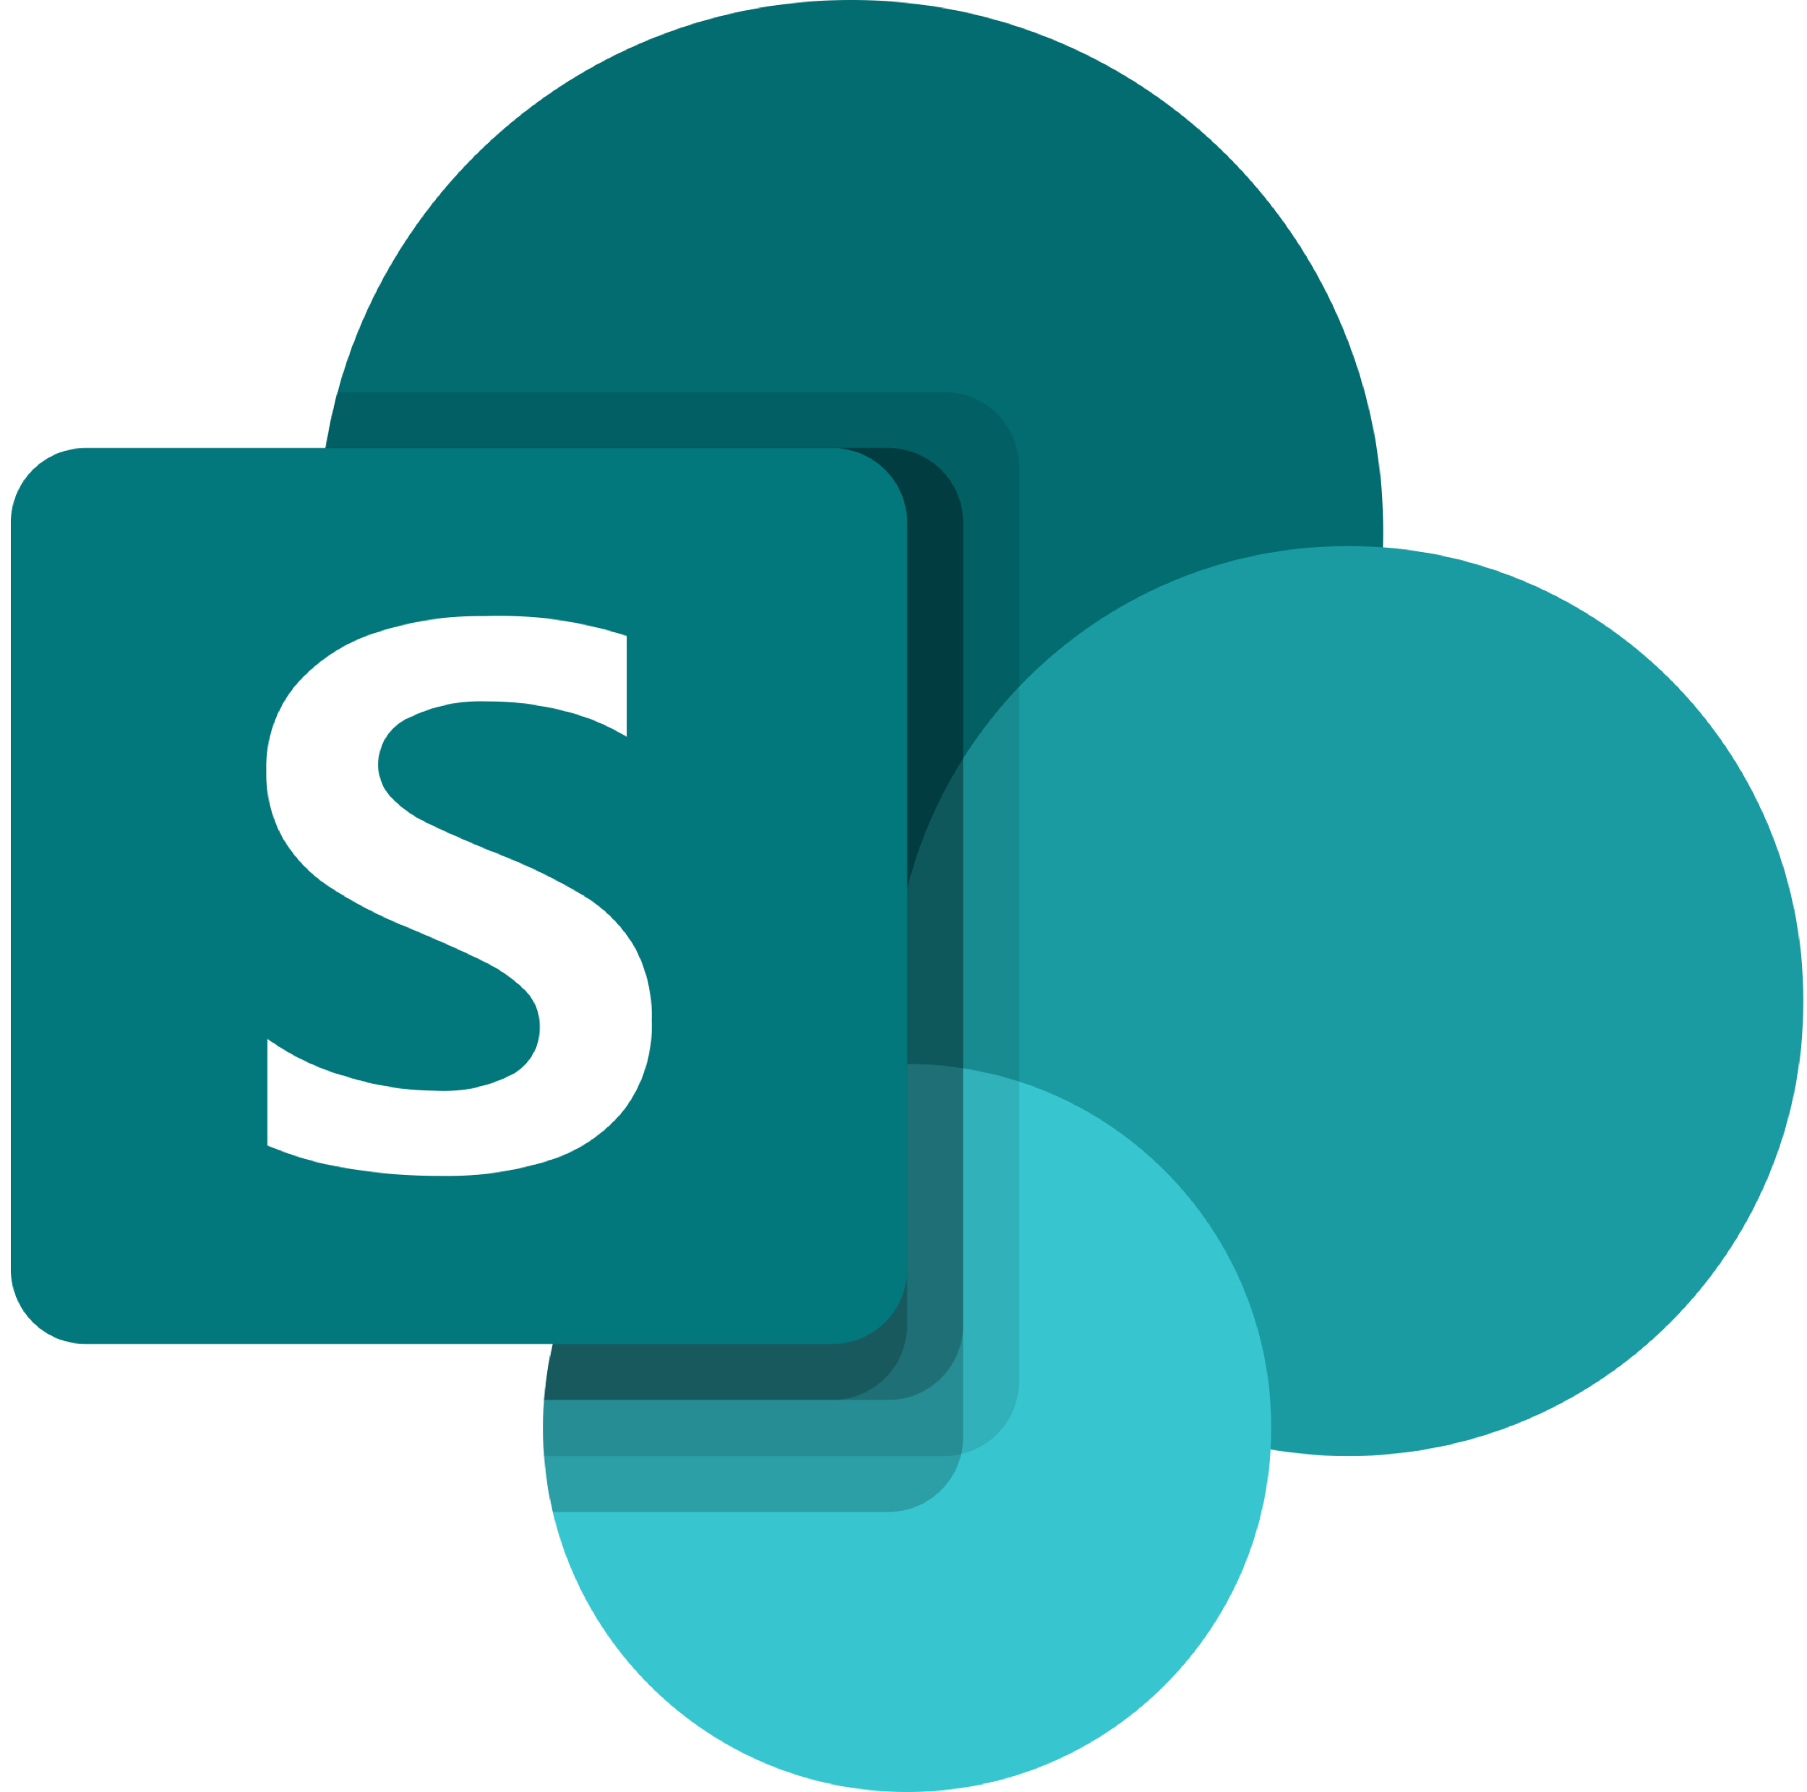

Extension & Integration
HMI / SCADA
AVEVA Teamwork
Real time view into production metrics, trigger posts from MES to Teamwork and reverse
News posts can be turned into work orders in the CMMS
Posts related to downtime can be synchronized with ERP logs
Bi-directional links between SoPs in QMS and instructions
Skills can feed updates to LMS on status of worker competencies, skills can link to content in LMS
MES
CMMS
Workers
USER MANAGEMENT
ERP
Management
QMS
CONTENT
Corporate
LMS
Notes:
AVEVA Teamwork solves the challenges with knowledge and skills gaps on the plant floor, but can also be leveraged as part of your greater operations technology strategy.
News posts can be turned into work orders in the CMMS
Bi-directional links between SoPs in QMS and instructions
Dashboard feature allows real time view into production metrics, trigger posts from MES to Teamwork and reverse
Skills can feed updates to LMS on status of worker competencies, skills can link to content in LMS
Posts related to downtime can be synchronized with ERP logs
The role of AVEVA Teamwork: Closing the knowledge loop through a digital tool and continuous improvement.
Knowledge is living and breathing, evolving, growing and updating. Not static. Not locked down.

Slide 15

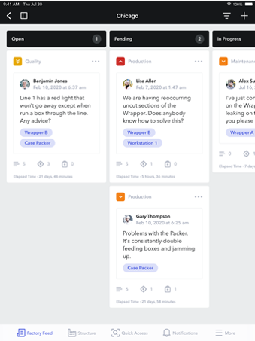
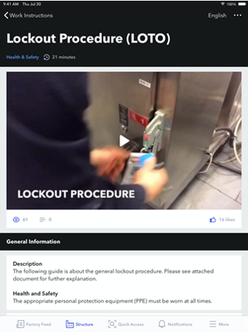
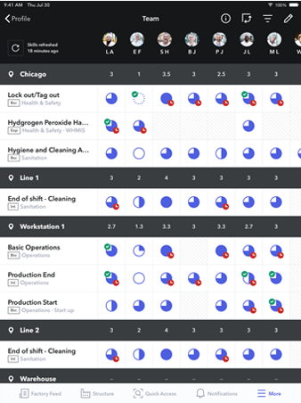




Quick Time to Value Through Phased Adoption
Communication & Daily Collaboration
Issue Identification & Management
Curate & Build Digital Knowledge
Implement Skills Development
Phase 1
Phase 2
Phase 3
User Adoption
(Culture)
Anyone who has used social media or has recorded video and taken pictures on their phone should be familiar with using Teamwork’s concepts.
Implementation
(Technical Requirements)
Teamwork is Software-as-a-Service. No installation required beyond downloading the app onto mobile devices. Setup is completed through a configuration methodology to define equipment structures, create content categories and add users.
Notes:
AVEVA Teamwork is optimally deployed as a phased transformation beginning with the daily management and problem-solving communication activities that are quick to implement and provide immediate value to the organization. This builds confidence and user adoption while a library of work instructions and content is created, and the skills development framework is defined.
Adoption is a critical aspect of any user-centric application, fortunately, AVEVA Teamwork utilizes intuitive navigation and workflows that are seen in many common consumer applications such as social media and recording video on a phone. This can help with the cultural shift that may be required.
In addition, from an implementation standpoint, there is no installation or coding required. The Teamwork foundation is configured by building a hierarchy of locations for equipment, defining categories for content and creating user accounts.

Slide 16
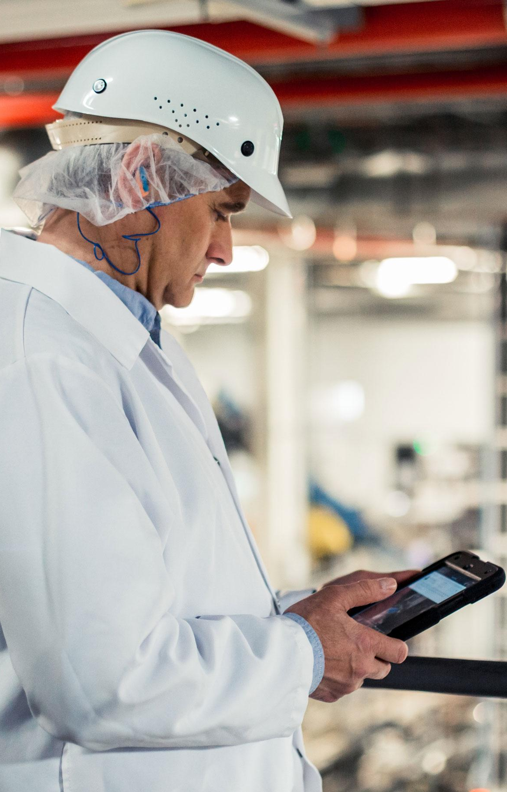
Digital Transformation with AVEVA Teamwork
60%
Decrease in
Accidents
9%
Reduction in Waste
50%
Reduction in Training Time
Safety
Waste
Training
4%
OEE Improvement
50% Reduction in
Non-Quality Rates
18%
Increase in worker productivity
Productivity
Quality
Productivity
Notes:
AVEVA Teamwork brings knowledge sharing and collaboration to the connected worker. Existing users have experienced manufacturing focused improvements including a 34% decrease in safety near misses, a 9% reduction in waste, 4% OEE improvement and a 50% reduction in non-quality rates, in addition to building their digital knowledge stores and reducing training time.
As a next step, we can jointly go through an AVEVA Teamwork Savings Calculator that can provide a basic and upfront ROI to understand how Teamwork may benefit your organization.

Slide 17
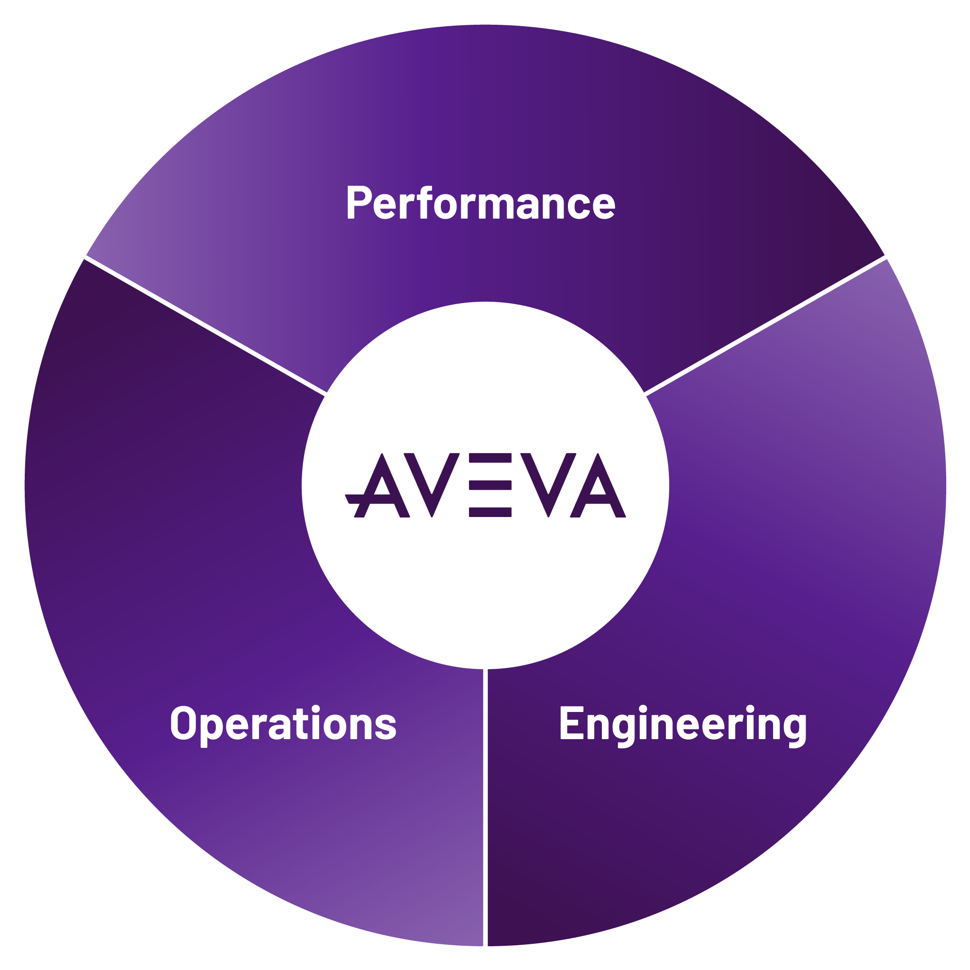
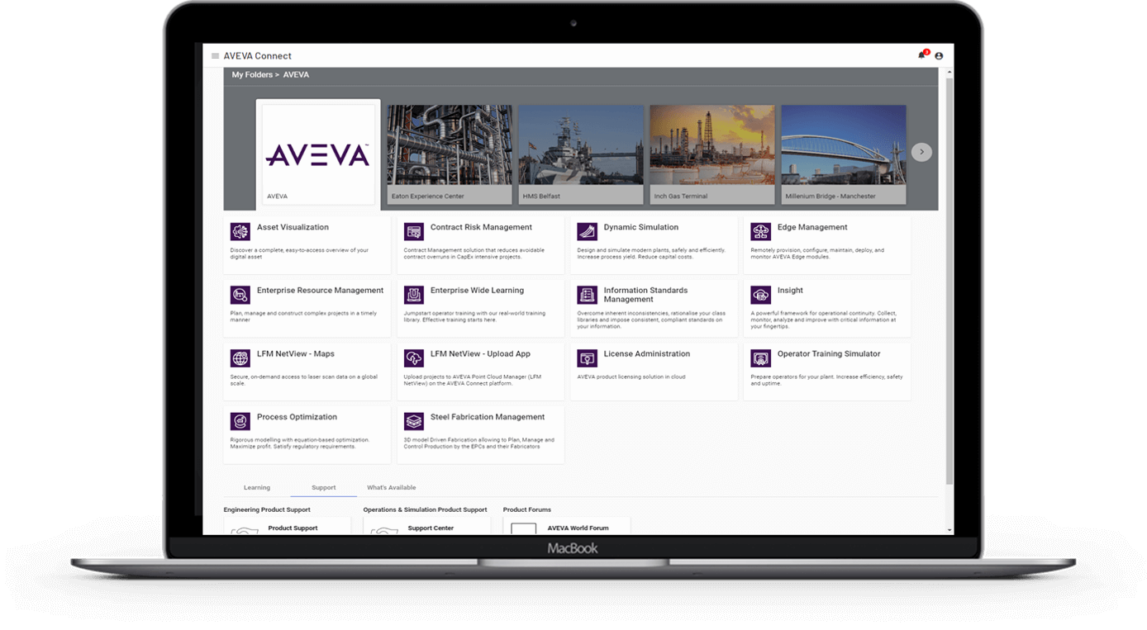

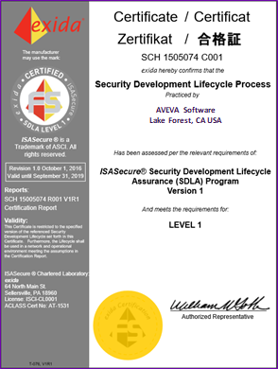

Digital acceleration with AVEVA software in the Cloud
Drive business resiliency. Transform faster, reduce costs and easily scale.
Working with
2,900+
Cloud customers globally
Fast
The broadest and deepest industrial software with seamless collaboration in a single out-of-the-box cloud hub
AVEVA
Rapid time to value
Fast deployment
Improve decision-making
Scalable commercial model
Allow hybrid environments
Lower total cost of ownership
Flexible
Per week more than
80,000
user logins
AVEVA Connect
our common cloud platform
Seeing at least
20%
efficiency gain by moving to Cloud
One single source of truth
Transparent collaboration
Empower remote working
Certified data security
> 99% uptime
Reduce IT dependency
Our proven technology and expertise helping you reduce the time to value and improve your business agility.
Collaborative
Secure

